Slide 1

ai-enhanced waste management system
PRESENTATION BY
S.SATWIKA - 20R21A12A6
M.SRESHTA - 20R21A1289
M.DEVI SREE - 20R21A1288

Slide 2

AI - ENHANCED WASTE MANAGEMENT SYSTEM
PAGE 02
PROBLEM STATEMENT
Waste management is a critical challenge in urban environments, as the world grapples with rising population densities and increased waste generation. Traditional waste management systems often suffer from inefficiencies, such as irregular collection schedules, high operational costs, and an adverse environmental impact. The lack of real-time data and decision support tools hampers the optimization of waste collection, recycling, and disposal processes.

Slide 3

AI - ENHANCED WASTE MANAGEMENT SYSTEM
PAGE 03
INTRODUCTION
The management of waste has emerged as one of the foremost challenges in our increasingly urbanized and technologically advanced world. As urban populations grow, so does the volume of waste generated, placing immense pressure on traditional waste management systems. To combat this issue and strive for a cleaner, more sustainable future, the integration of artificial intelligence (AI) into waste management has become a transformative solution. AI, with its ability to process vast amounts of data and make intelligent decisions, offers a paradigm shift in the way we approach waste collection, sorting, and disposal.

Slide 4

AI - ENHANCED WASTE MANAGEMENT SYSTEM
PAGE 04
ABSTRACT
The AI-Enhanced Waste Management System represents a cutting-edge approach to addressing the global challenge of waste disposal and environmental sustainability. With the rapid increase in urbanization and population growth, traditional waste management methods have become inadequate and inefficient. This innovative system leverages artificial intelligence (AI) technologies, including machine learning and computer vision, to optimize every aspect of waste management. It starts with smart waste collection, where sensors and cameras installed in waste bins monitor their fill levels and contents in real-time. The AI algorithm then schedules collection routes dynamically, reducing unnecessary trips and fuel consumption while ensuring timely pickups.

Slide 5
AI - ENHANCED WASTE MANAGEMENT SYSTEM
PAGE 05
OBJECTIVES
1.Resource Conservation:
AI-powered sorting systems can accurately identify recyclable materials from mixed waste streams. This promotes higher recycling rates, reduces contamination, and conserves valuable resources.
2.Environmental Impact Reduction:
Optimized waste collection routes and increased recycling rates directly lead to a reduction in carbon emissions, contributing to a cleaner environment and helping combat climate change
3.Efficiency and Optimization:
AI algorithms can analyze data from sensors and cameras in real-time, allowing waste collection routes to be dynamically optimized. This reduces fuel consumption, minimizes operational costs, and ensures timely waste pickups.
4.Resource Conservation:
AI-powered sorting systems can accurately identify recyclable materials from mixed waste streams. This promotes higher recycling rates, reduces contamination, and conserves valuable resources.

Slide 6
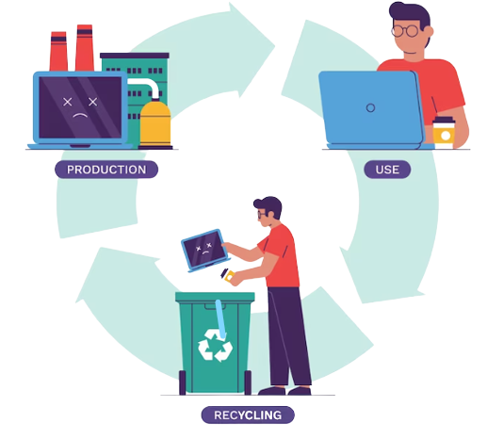
AI - ENHANCED WASTE MANAGEMENT SYSTEM
PAGE 06
PROPOSED SYSTEM

Slide 7

AI - ENHANCED WASTE MANAGEMENT SYSTEM
PAGE 07
COLLECTION
For route optimization in waste collection, algorithms like the Vehicle Routing Problem (VRP) with constraints. VRP algorithms, including variants like the Capacitated VRP (CVRP) and the Time-Window VRP (TSP), are designed to optimize vehicle routes subject to capacity and time constraints. Depending on the constraints and scale of the problem, we can choose the most appropriate VRP variant.

Slide 8
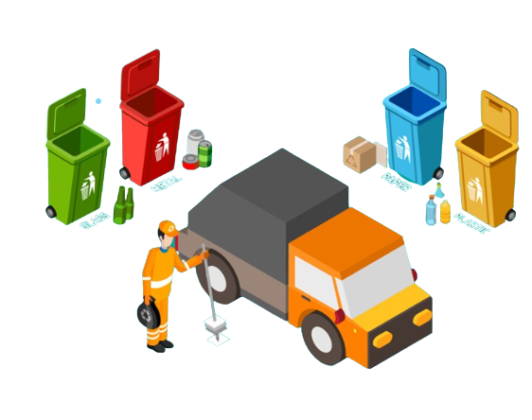
AI - ENHANCED WASTE MANAGEMENT SYSTEM
PAGE 08
SEGGREGATION
For waste sorting, we implement AI and computer vision-based algorithms, such as Convolutional Neural Networks (CNNs). CNNs are highly effective for image classification tasks, including recognizing and sorting different types of waste materials. Training a CNN on a diverse dataset of waste images can help achieve high accuracy in waste sorting.

Slide 9
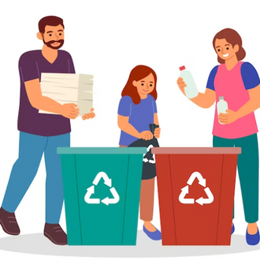


AI - ENHANCED WASTE MANAGEMENT SYSTEM
PAGE 09
SERVICES
Buy recyclable waste
Facilitate collaboration with small businesses that make products with recycled materials.
Education on recycling

Slide 10
AI - ENHANCED WASTE MANAGEMENT SYSTEM
PAGE 10
ARCHITECTURE
RECYCLING COMPOSTING INCINERATION
LANDFILLS HAZARDOUS WASTE DISPOSAL
COLLECTION
TRANSPORTATION
PUBLIC EDUCATION AND OUTREACH
TRANFER STATIONS
PROCESSING AND SORTING
MONITORING AND REGULATION

Slide 11



AI - ENHANCED WASTE MANAGEMENT SYSTEM
PAGE 11
IMPLEMENTATION
STEP 01
Monitor your route. Input your location details or use GPS to track your route.
STEP 02
Explore available services. Find the perfect solution for your recycled waste needs.
STEP 03
Get the service you need.

Slide 12
AI - ENHANCED WASTE MANAGEMENT SYSTEM
PAGE 12
LITERATURE SURVEY
Name of the Author | Method | Advantages
Shubham Thakker and R.Narayanamoorthi [2009] | GSM System | Server whenever a bin is full
Mohd Helmy Abd Wahab et al [2013] | RFID tags | Detect the identity of the person throwing the garbage
C.K.M. Lee and Trevor wu [2015] | GPRS System | Send the sensor data to a mobile app over the cloud

Slide 13

AI - ENHANCED WASTE MANAGEMENT SYSTEM
PAGE 13
RESEARCH QUESTIONS
1.How can AI be effectively integrated into waste management processes to enhance recycling and reduce environmental impact?
The effective integration of AI involves automating waste sorting, optimizing collection routes, and providing recycling education through AI-driven insights.
2.What technological advancements and trends are expected to shape the future of AI-enhanced waste management systems?
Advancements in sorting technologies, predictive analytics, and circular economy integration are expected to improve efficiency and sustainability in waste management systems.
3.What are the environmental and economic benefits of implementing AI in waste management systems?
Implementing AI in waste management can lead to reduced carbon emissions, lower operational costs, increased recycling rates, and minimized environmental impact.
4.How can public awareness and engagement in responsible waste management practices be effectively increased through AI-generated insights and personalized incentives?
AI-generated insights can provide real-time information and recycling tips through user-friendly apps, while personalized incentives can motivate the public to participate in responsible waste management.

Slide 14


AI - ENHANCED WASTE MANAGEMENT SYSTEM
PAGE 14
GITHUB URL

Slide 15



AI - ENHANCED WASTE MANAGEMENT SYSTEM
PAGE 15
CONCLUSION
The implementation of an AI-enhanced waste management system offers a transformative solution to the complex challenges of modern waste management. By harnessing the power of real-time data analytics and machine learning, this system promises enhanced efficiency, reduced operational costs, and a substantial reduction in environmental impact. Moreover, it empowers communities to actively participate in sustainable waste reduction and recycling practices. Ultimately, the integration of AI in waste management marks a significant step towards creating cleaner, more sustainable, and environmentally responsible urban environments.

